Slide 1
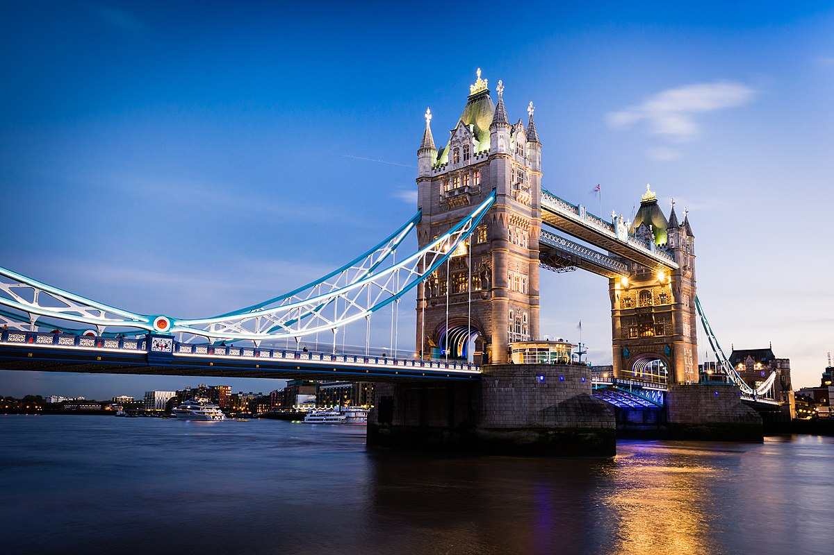
London bridge
By Samuel

Slide 2
Interesting facts
London Bridge is a bridge over the river Thames
Opened March 17, 1973
The name London Bridge is often mistakenly applied to Tower Bridge, which is the next bridge down stream

Slide 3
Length and height and width
883 feet length
29 feet height
Width 105 feet

Slide 4
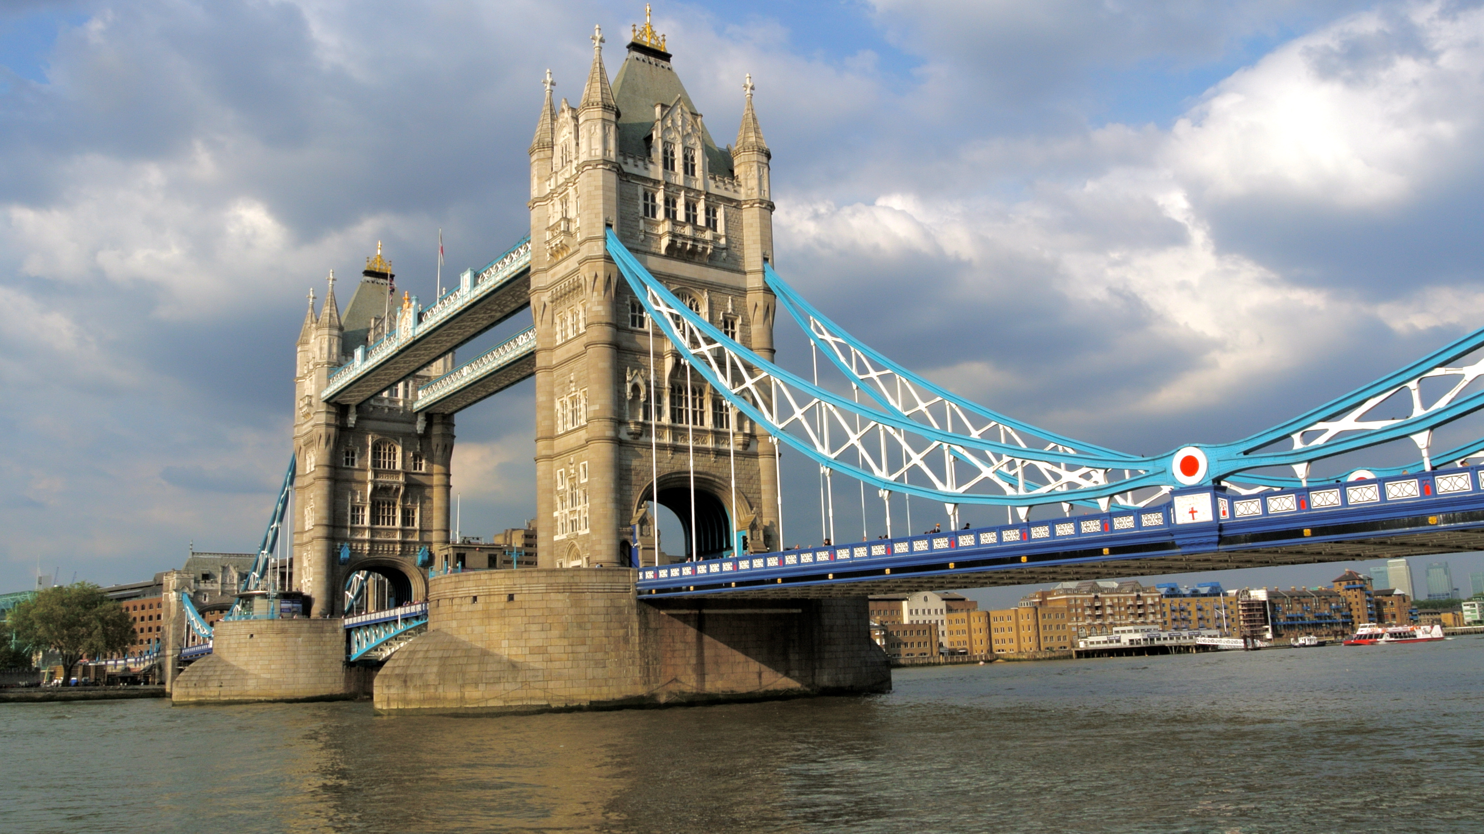
comparison
The London Bridge is 423 feet longer than the Capilano suspension bridge.

Slide 5
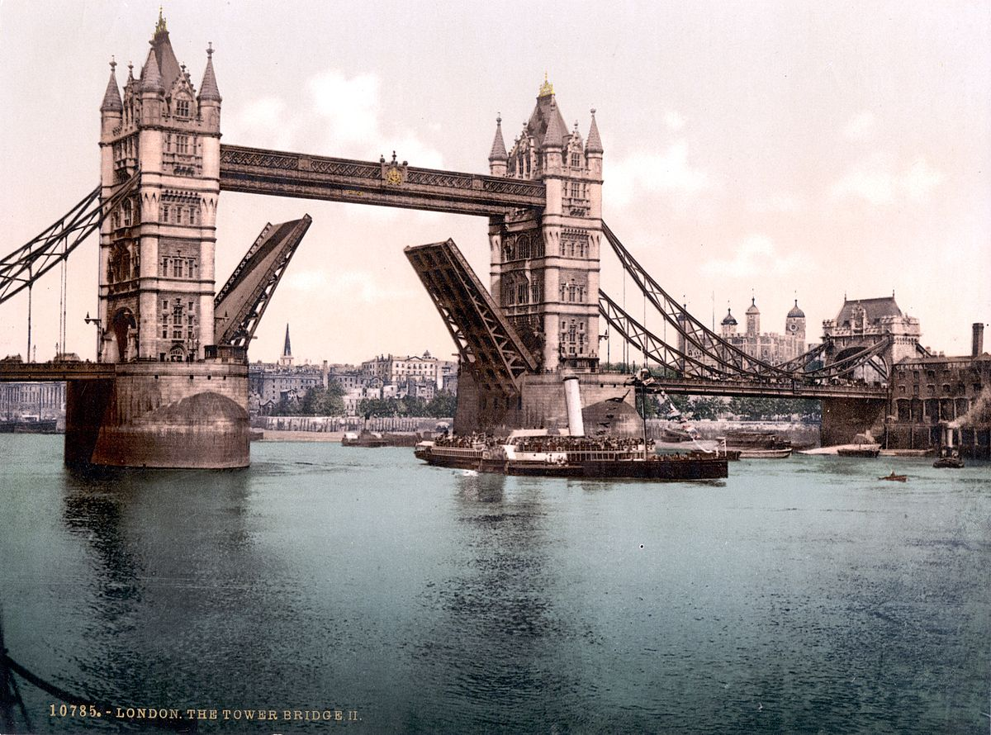
pictures
Here is a pic before we go

Slide 6
Researched and Produced by Samuel 2nd Grade
Buck Lake Elementary, Tallahassee, FL 2019

